Slide 1
Notes:
In the next activity, the answer can be yellow, purple, blue, or red.

Slide 2
Notes:
Let’s make sure it is working! Tell me when you see each color on the screen!

Slide 10

Notes:
Great! In this activity, all the questions will be about this picture. This is a picture of a field where people can play sports.

Slide 11

Notes:
For example here is a soccer ball. One of the sports people could play on this field is soccer!

Slide 12
Notes:
Now there is an arrow pointing to a box. The box is the goal! So when the ball goes into the goal, one of the teams scores a point!

Slide 13
Notes:
I made the goal red in this picture so it is even easier to see!

Slide 14
Notes:
So here is the field with the ball and the goal. There is one more really important thing about the field. Sometimes, there is a big wooden block on the field.

Slide 15
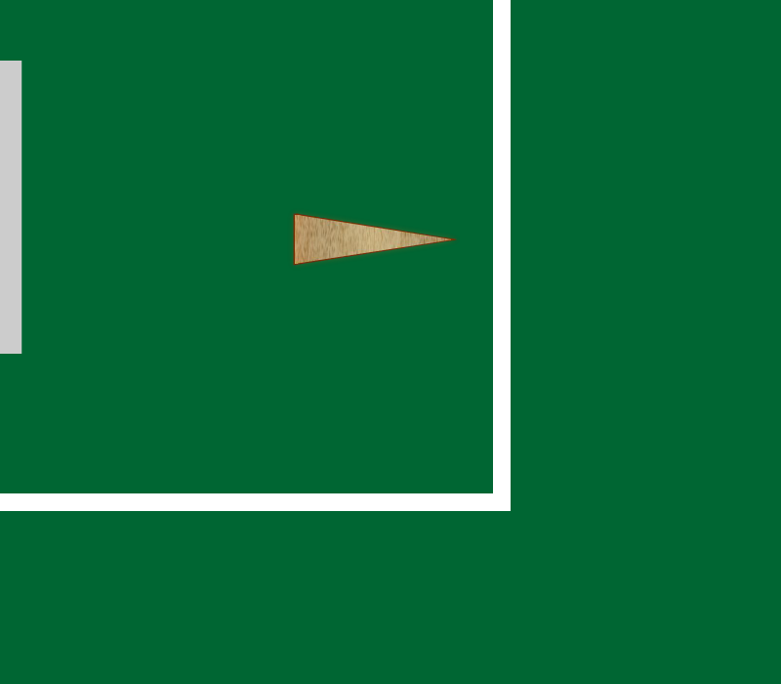
Notes:
Here is the big wooden block. If the ball hits the block, the ball can bounce and go in a new direction!
Now I’m going to show you some short videos of the ball moving, and after each one I’ll ask you a question about it.

Slide 16
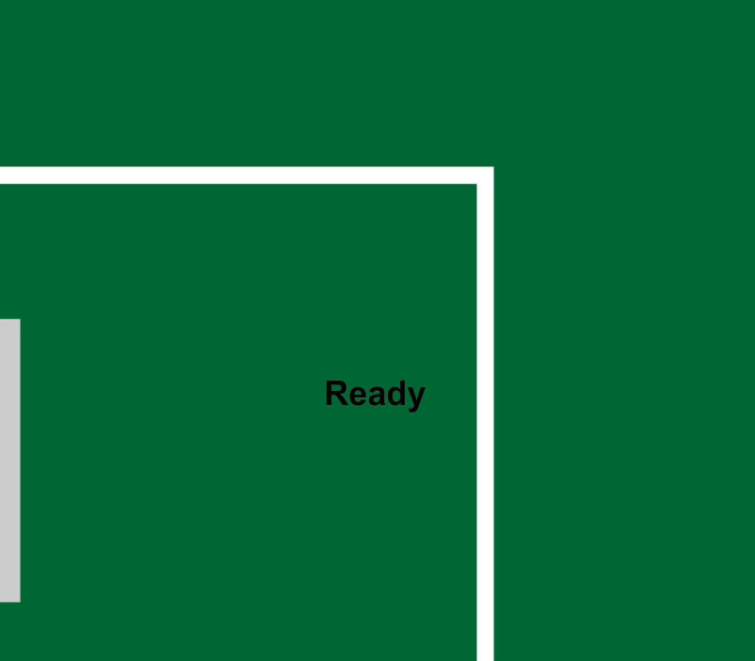
Notes:
T_A_inv

Slide 17
Notes:
Can you tell me which one of the pictures on the sides shows where the ball went?

Slide 18
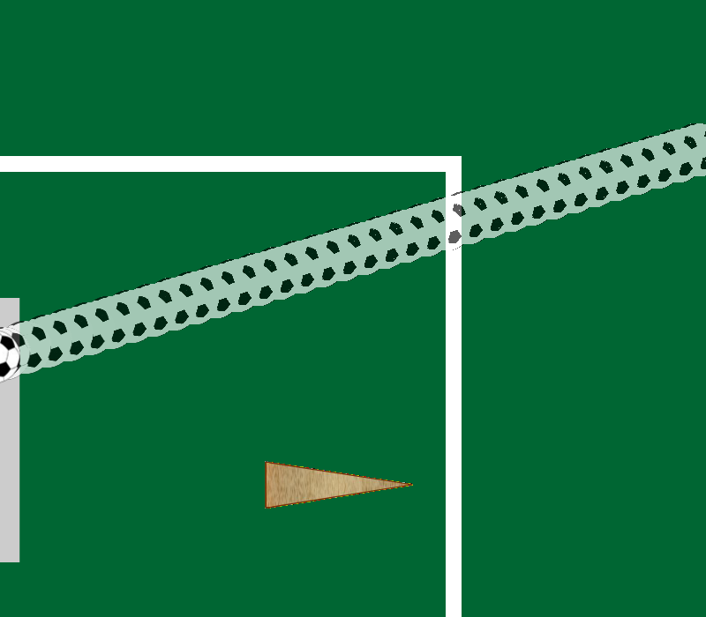
Notes:
Is it in Yellow…

Slide 19
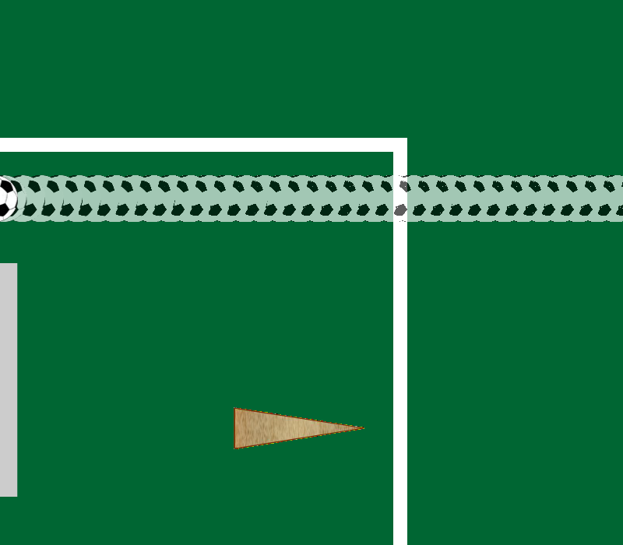
Notes:
Purple…

Slide 20
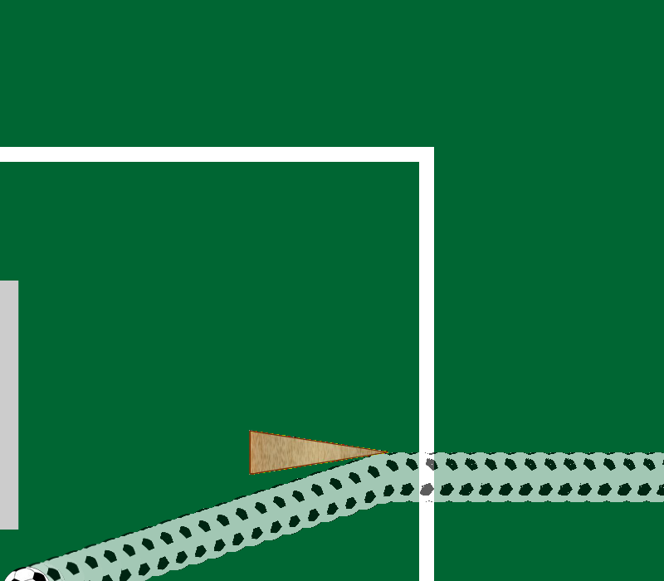
Notes:
Blue…

Slide 21
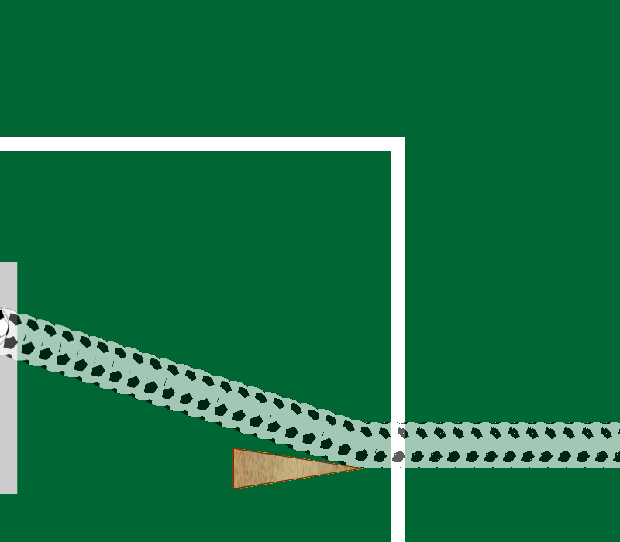
Notes:
Or Red?

Slide 22
Notes:
T_C_inv

Slide 23
Notes:
Which path did the ball take?

Slide 24
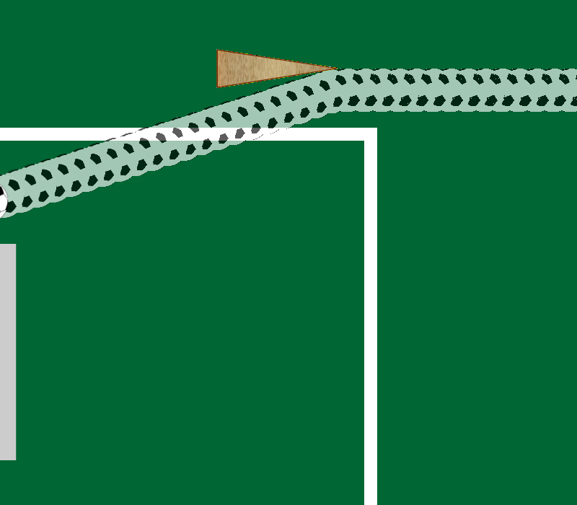
Notes:
Is it Yellow…

Slide 25
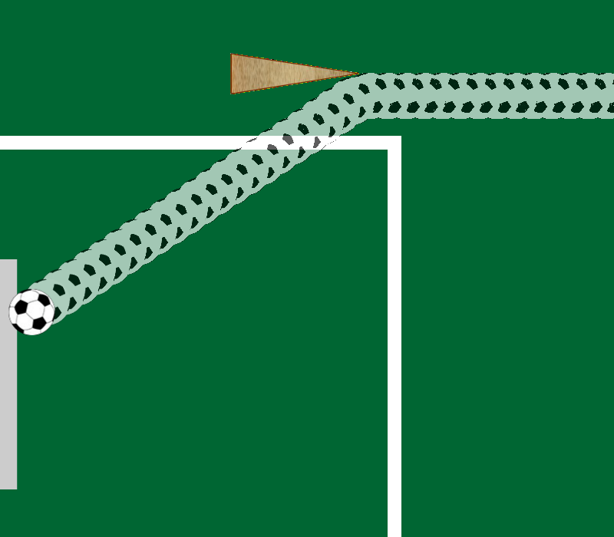
Notes:
Purple…

Slide 26
Notes:
Blue…

Slide 27
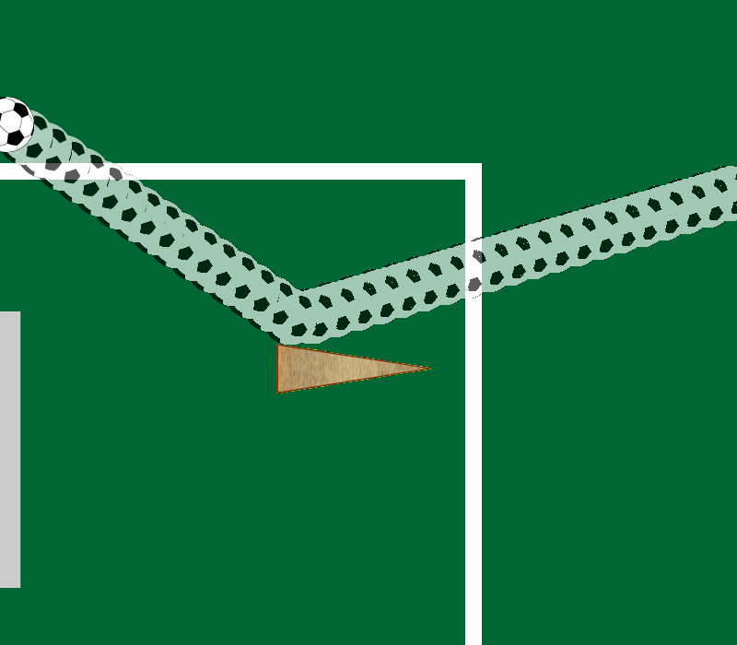
Notes:
Or Red?

Slide 28
Notes:
Watch this!

Slide 29
Notes:
Great work so far! Now the activity will be a little bit different. You’ll watch the video, but then….

Slide 30
Notes:
I’ll show you a picture of what actually happened in the middle

Slide 31
Notes:
And some paths the ball could have taken in the boxes on the side. I’ll ask you what path the ball would have taken if there had been no block on the field.

Slide 32
Notes:
Watch this!

Slide 33
Notes:
2_2_inv

Slide 34
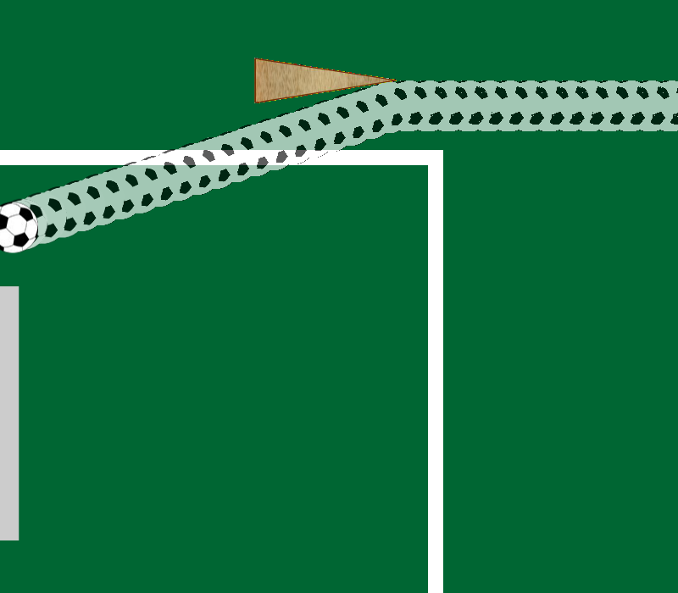
Notes:
In the center is a picture of what actually happened. Now, If there were no block on the field, which path would the ball have taken?

Slide 35
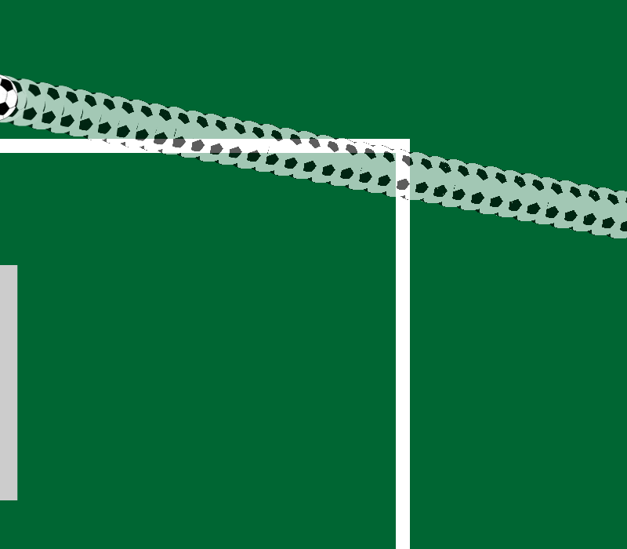
Notes:
Is it Yellow…

Slide 36
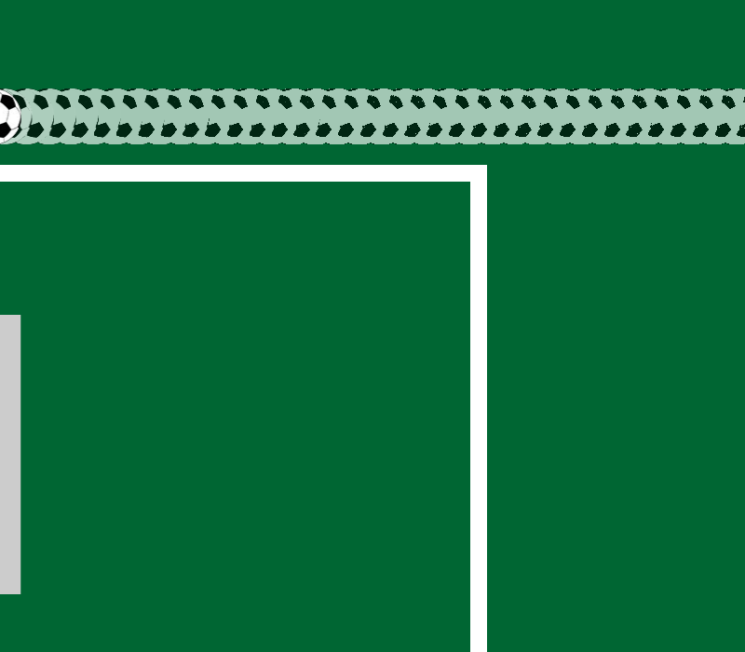
Notes:
Purple…

Slide 37
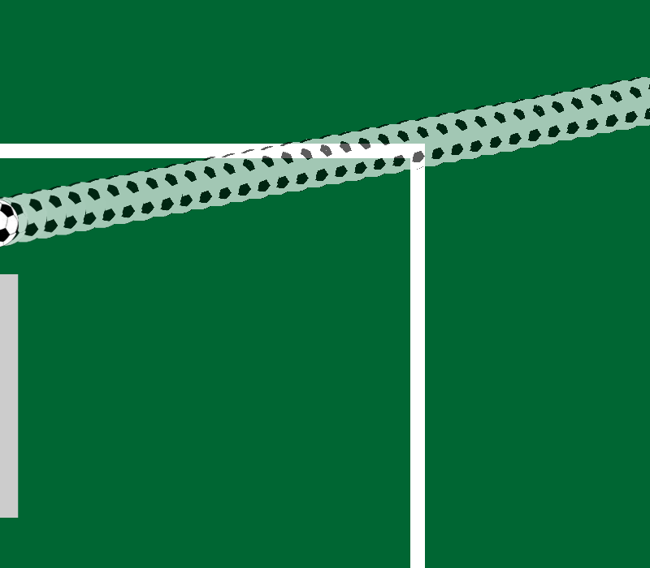
Notes:
Blue…

Slide 38
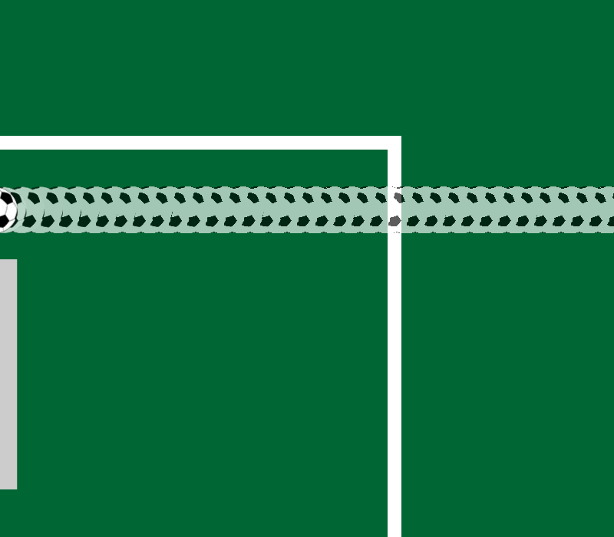
Notes:
Or Red?

Slide 39
Notes:
Watch this!

Slide 40
Notes:
2_1_v1_inv

Slide 41
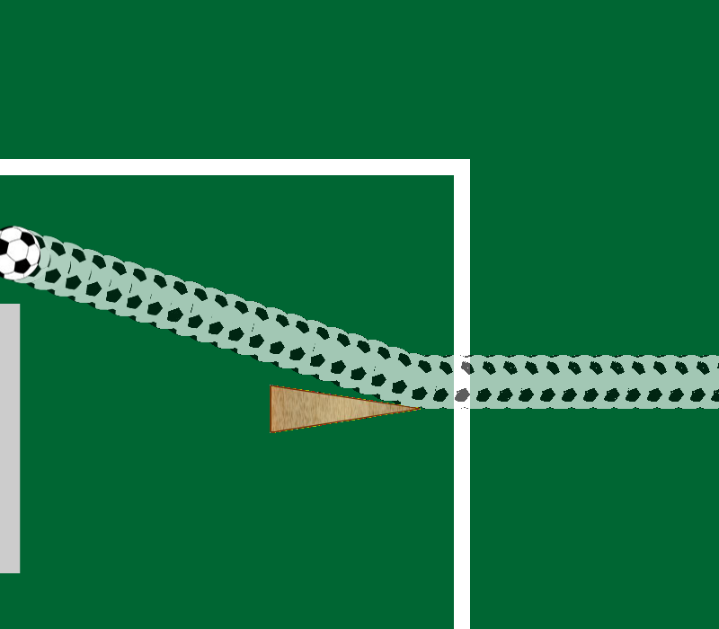
Notes:
In the center is a picture of what actually happened. Now, If there were no block on the field, which path would the ball have taken?

Slide 42
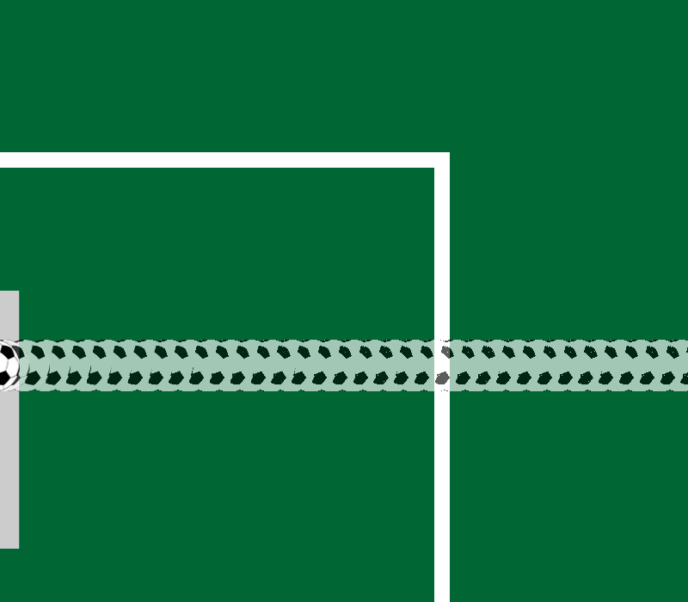
Notes:
Is it Yellow…

Slide 43
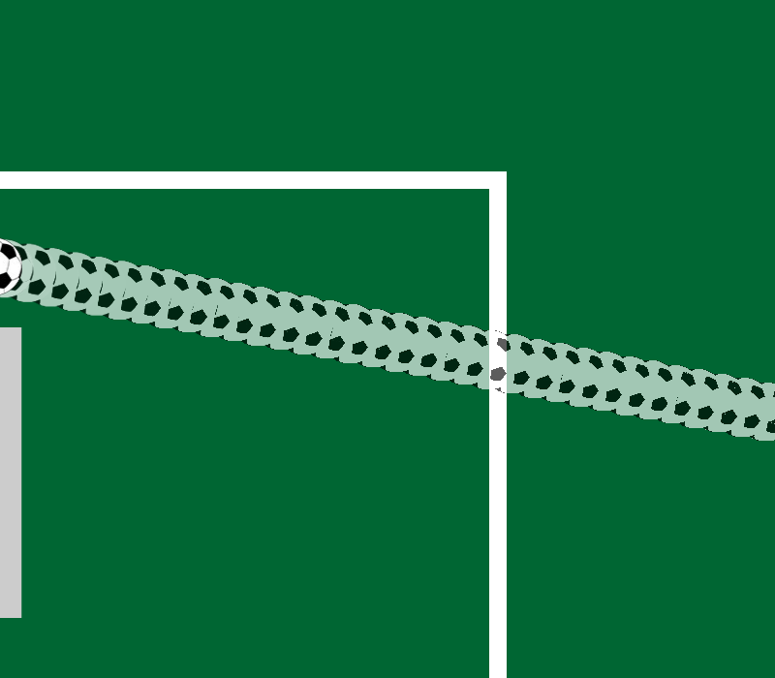
Notes:
Purple…

Slide 44
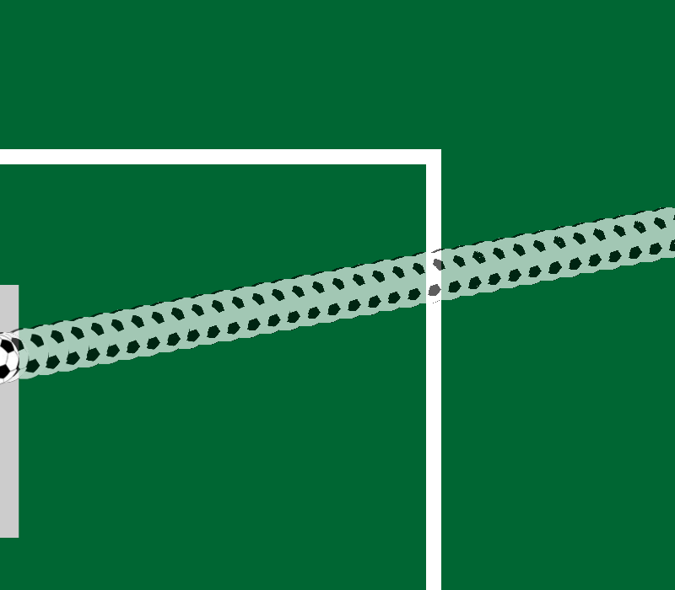
Notes:
Blue…

Slide 45

Notes:
Or Red?

Slide 46
Notes:
Watch this!

Slide 47
Notes:
1_2_inv

Slide 48

Notes:
In the center is a picture of what actually happened. Now, If there were no block on the field, which path would the ball have taken?

Slide 49

Notes:
Is it Yellow…

Slide 50
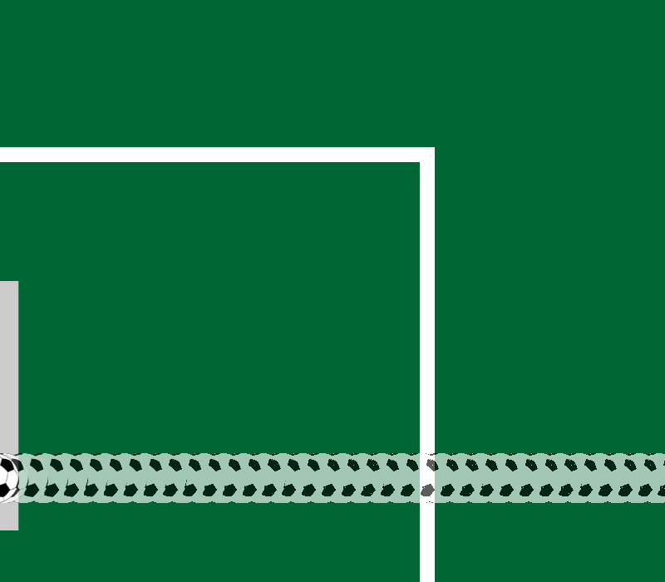
Notes:
Purple…

Slide 51
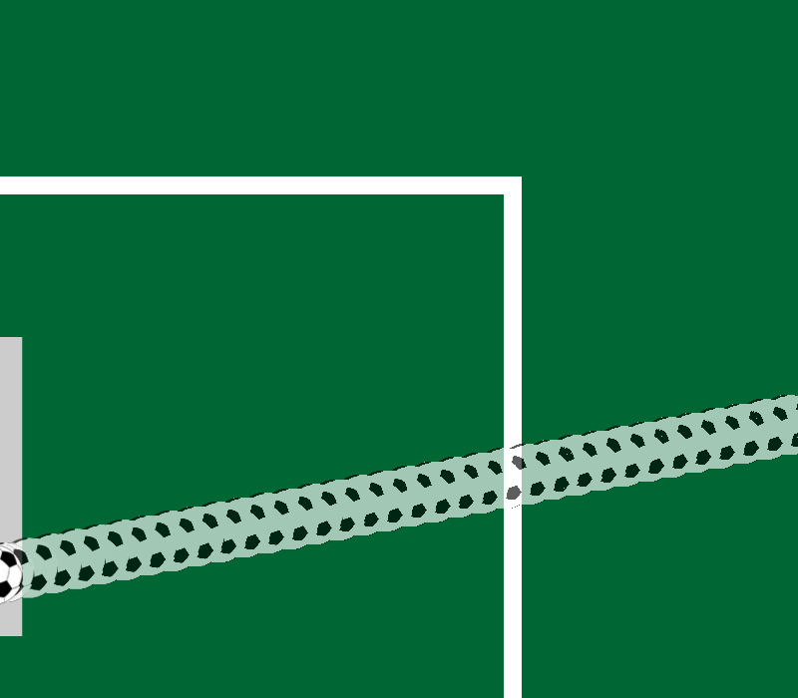
Notes:
Blue…

Slide 52
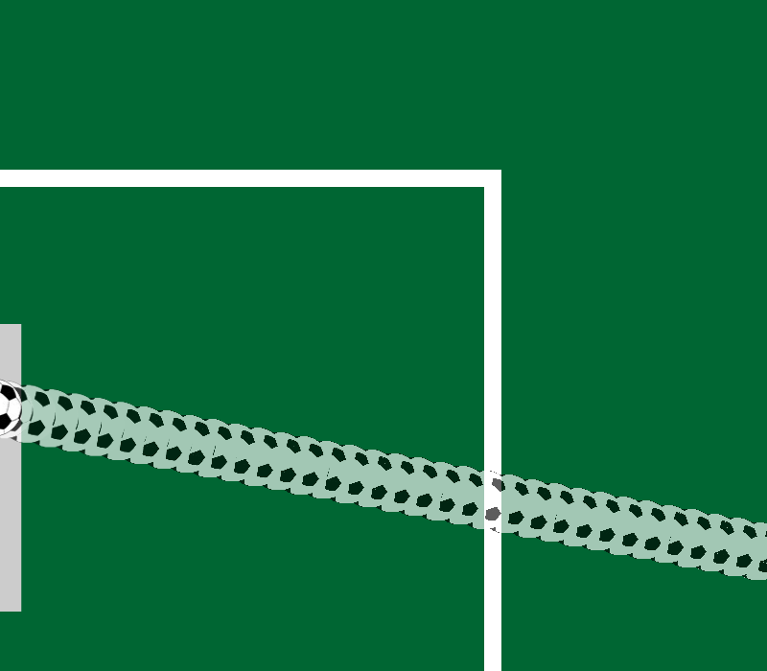
Notes:
Or Red?

Slide 53
Notes:
Watch this!

Slide 54
Notes:
2_1_v2_inv

Slide 55
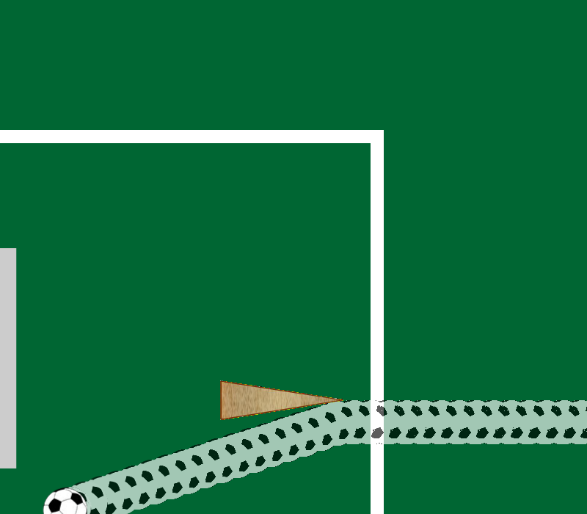
Notes:
In the center is a picture of what actually happened. Now, If there were no block on the field, which path would the ball have taken?

Slide 56
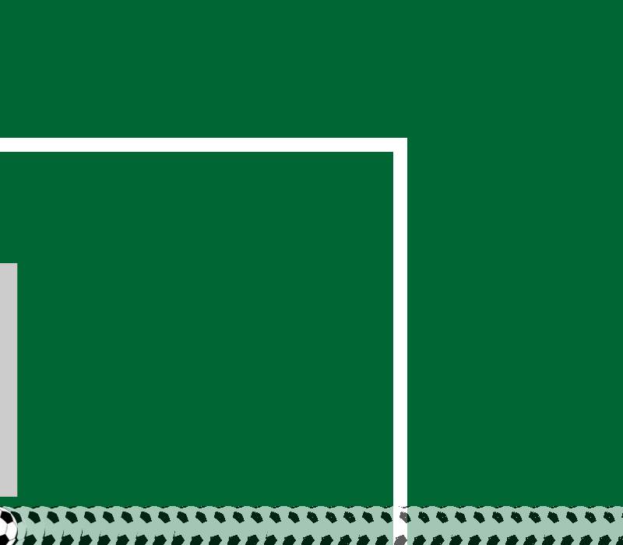
Notes:
Is it Yellow…

Slide 57
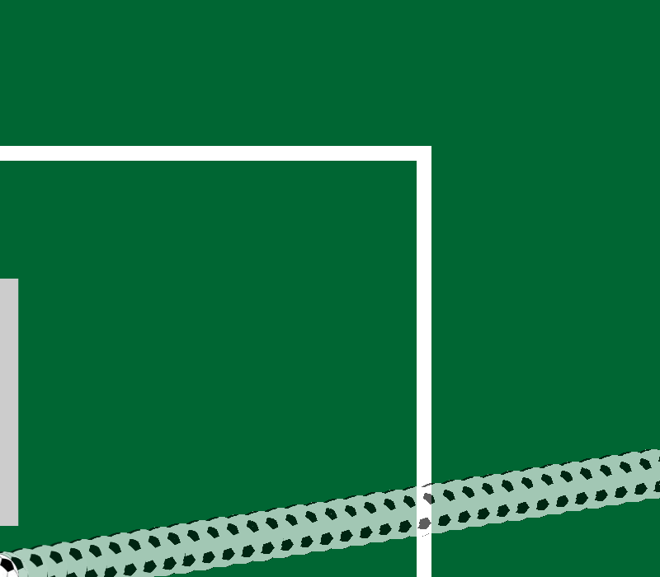
Notes:
Purple…

Slide 58
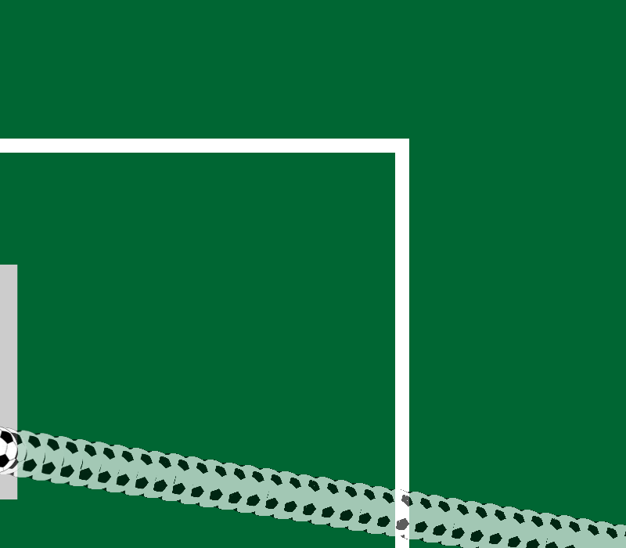
Notes:
Blue…

Slide 59
Notes:
Or Red?

Slide 60
Notes:
Watch this!

Slide 61
Notes:
1_3_inv

Slide 62
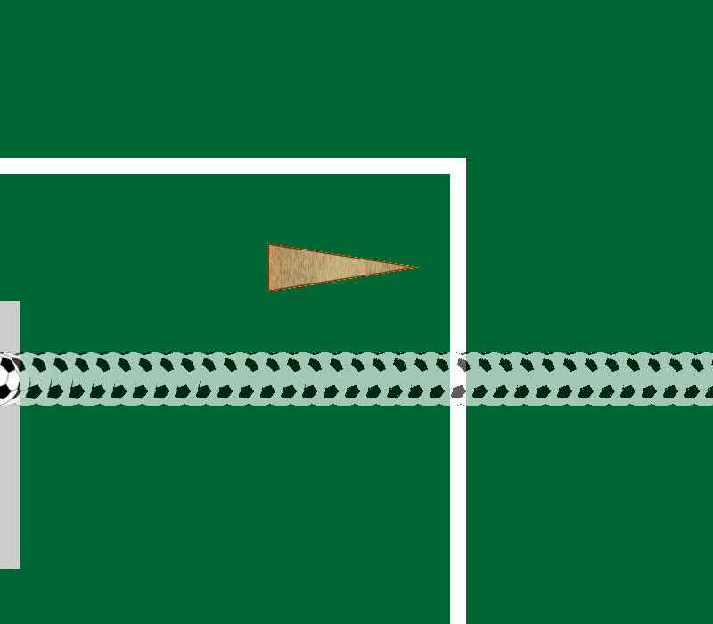
Notes:
In the center is a picture of what actually happened. Now, If there were no block on the field, which path would the ball have taken?

Slide 63
Notes:
Is it Yellow…

Slide 64
Notes:
Purple…

Slide 65
Notes:
Blue…

Slide 66
Notes:
Or Red?

Slide 67
Notes:
Watch this!

Slide 68
Notes:
2_3_inv

Slide 69
Notes:
In the center is a picture of what actually happened. Now, If there were no block on the field, which path would the ball have taken?

Slide 70
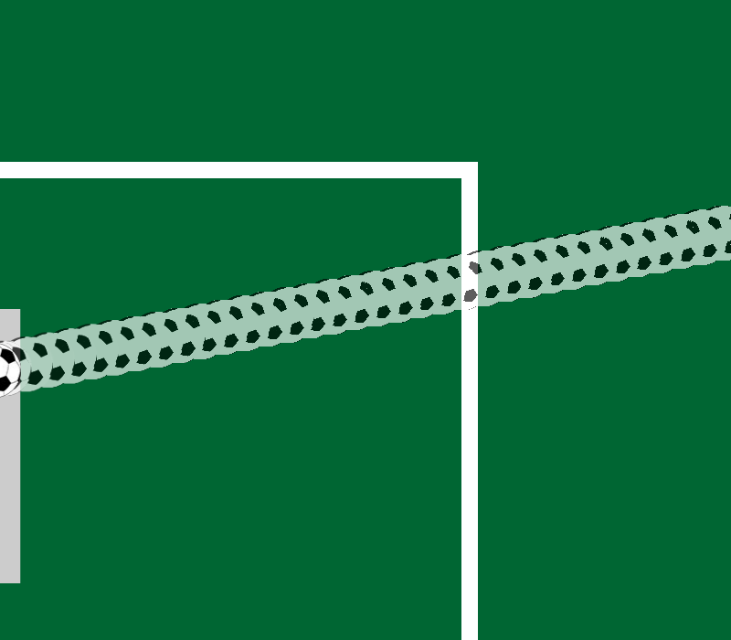
Notes:
Is it Yellow…

Slide 71
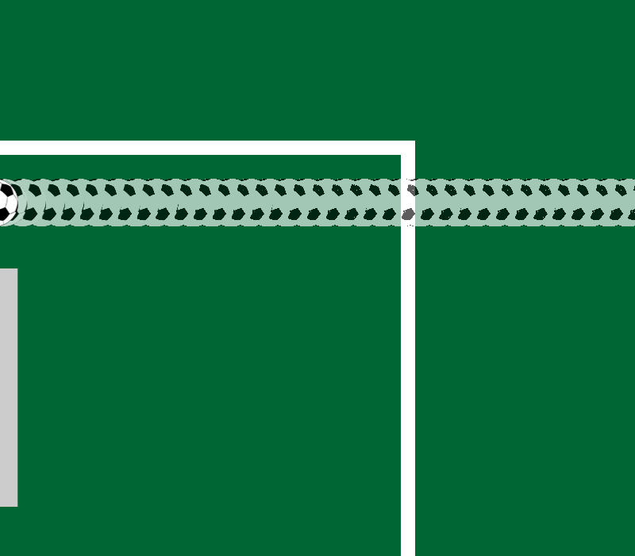
Notes:
Purple…

Slide 72
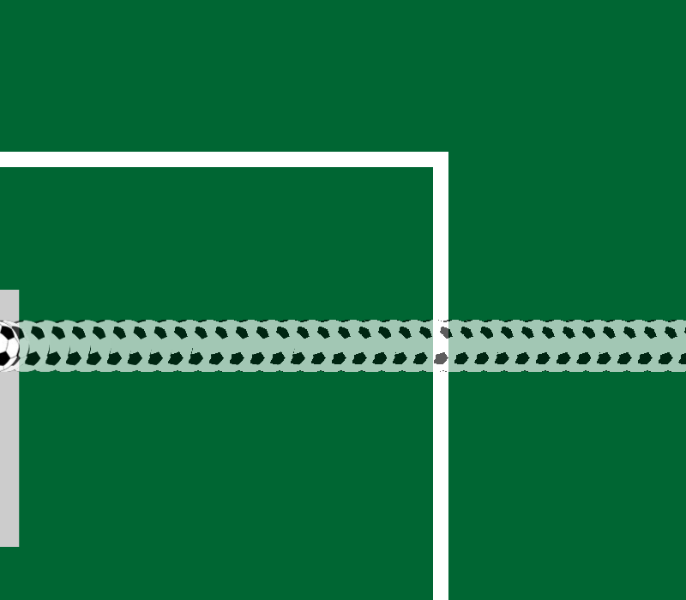
Notes:
Blue…

Slide 73
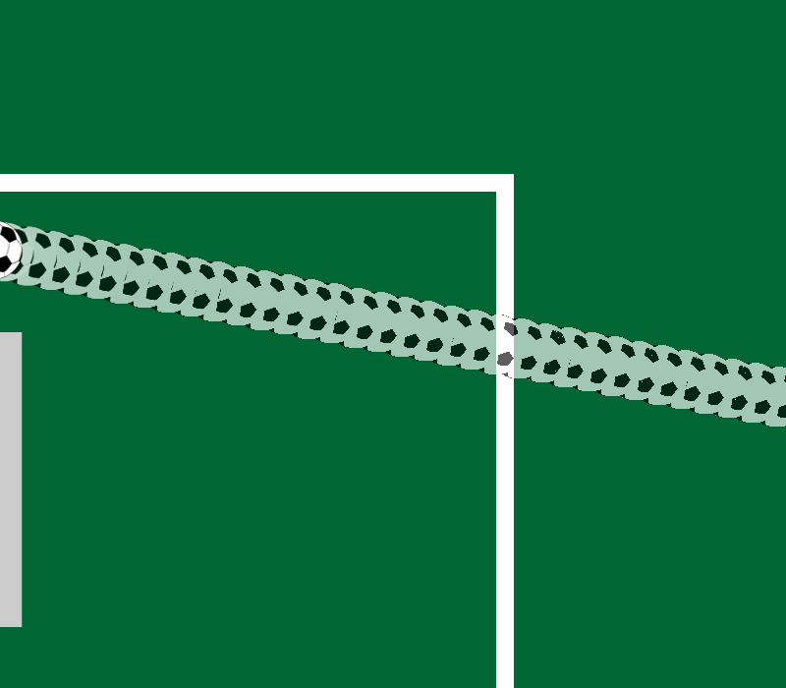
Notes:
Or Red?

Slide 74
Notes:
Watch this!

Slide 75
Notes:
1_1_v1_inv

Slide 76
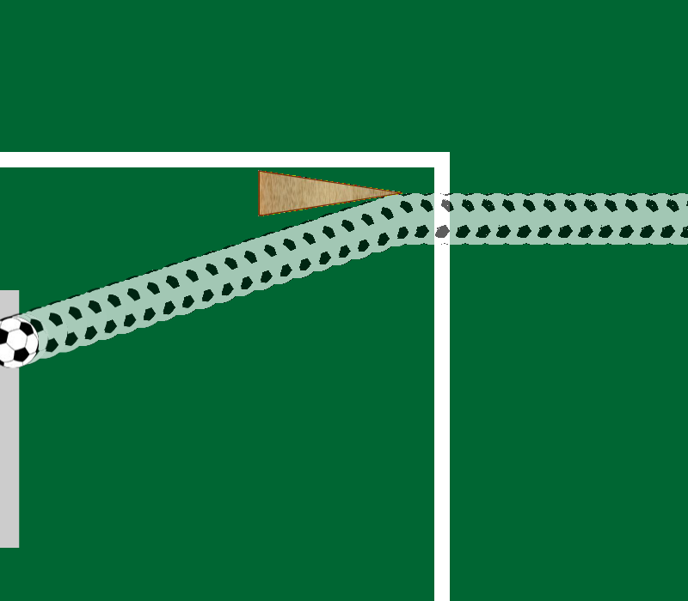
Notes:
In the center is a picture of what actually happened. Now, If there were no block on the field, which path would the ball have taken?

Slide 77
Notes:
Is it Yellow…

Slide 78
Notes:
Purple…

Slide 79
Notes:
Blue…

Slide 80
Notes:
Or Red?

Slide 81
Notes:
Watch this!

Slide 82
Notes:
1_1_v2_inv

Slide 83

Notes:
In the center is a picture of what actually happened. Now, If there were no block on the field, which path would the ball have taken?

Slide 84
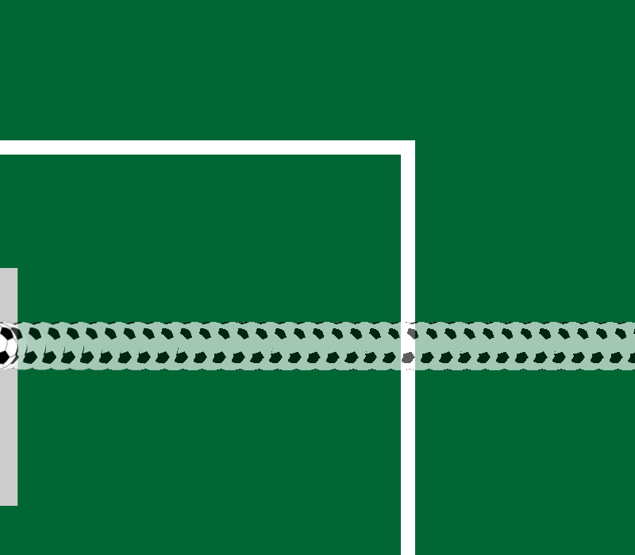
Notes:
Is it Yellow…

Slide 85
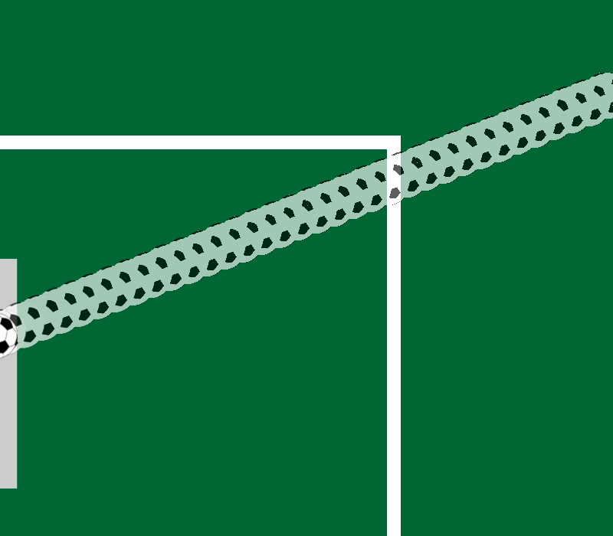
Notes:
Purple…

Slide 86
Notes:
Blue…

Slide 87
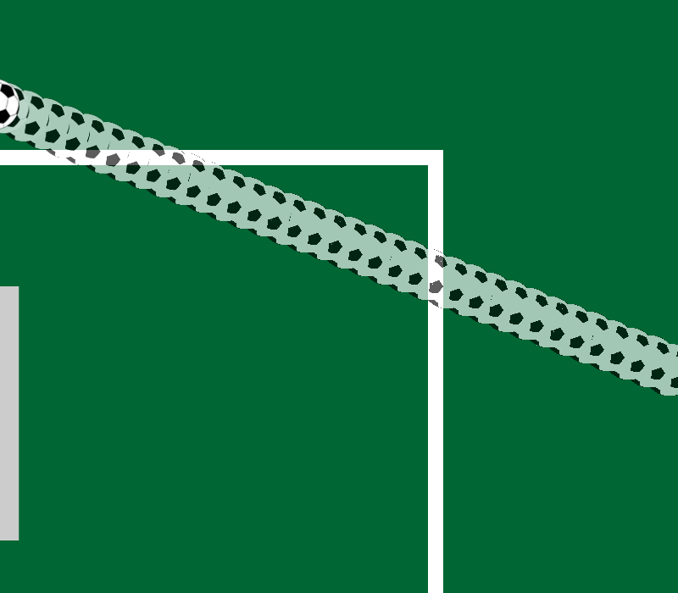
Notes:
Or Red?

Slide 88

Notes:
All done!

